Slide 1
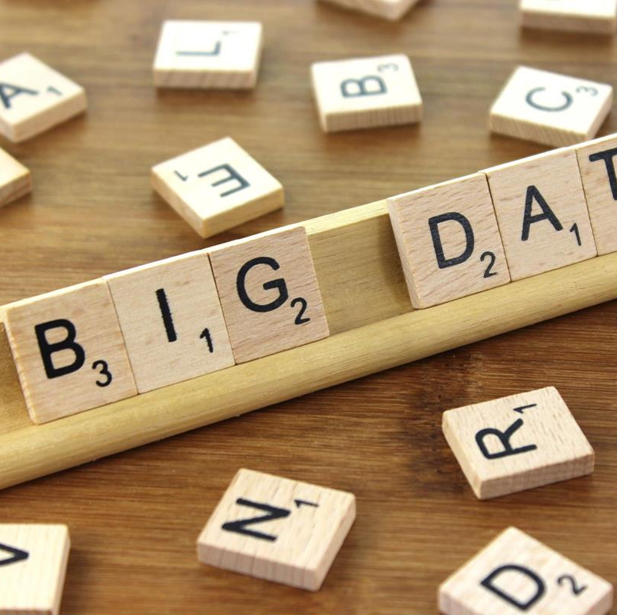
Big Data
Ahmad Raza 2017-ag-7297
Umer Munir 2017-ag-7217
Hassan Khalid 2019-ag-608
This Photo by Unknown author is licensed under CC BY-SA.

Slide 2
BIG DATA
What is Data
What is Big Data
Examples of Big Data
Types of Big Data
Characteristics of Big Data
Advantages Of Bog Data
Roles And relationship between Cloud Computing and Big Data
Difference Between Cloud Computing and Big Data
Conclusion

Slide 3
What is Data
The quantities, characters, or symbols on which operations are performed by a computer, which may be stored and transmitted in the form of electrical signals and recorded on magnetic, optical, or mechanical recording media.
What is Big Data?
Big Data is a collection of data that is huge in volume, yet growing exponentially with time. It is a data with so large size and complexity that none of traditional data management tools can store it or process it efficiently. Big data is also a data but with huge size.

Slide 4
Examples Of Big Data
New York Stock Exchange
Social Media
Jet engine
Stock exchanges
Media and Entertainment
Advertising and Marketing.

Slide 5
Types of Big Data
Following are the types of Big Data:
Structured
Unstructured
Semi-structured
Structured
Any data that can be stored, accessed and processed in the form of fixed format is termed as a ‘structured’ data. Over the period of time, talent in computer science has achieved greater success in developing techniques for working with such kind of data (where the format is well known in advance) and also deriving value out of it.

Slide 6
Structured Data
Over the period of time, talent in computer science has achieved greater success in developing techniques for working with such kind of data (where the format is well known in advance) and also deriving value out of it.
A Structured Query Language (SQL) is needed to bring the data together. Structured data is easy to enter, query, and analyze. All of the data follows the same format.

Slide 7
EXamples Structured Data
Employee_ID | Employee_Name | Gender | Department | Salary_In_lacs
2365 | Rajesh Kulkarni | Male | Finance | 650000
3398 | Pratibha Joshi | Female | Admin | 650000
7465 | Shushil Roy | Male | Admin | 500000
7500 | Shubhojit Das | Male | Finance | 500000
7699 | Priya Sane | Female | Finance | 550000
An ‘Employee’ table in a database is an example of Structured Data

Slide 8
Unstructured Data
Any data with unknown form or the structure is classified as unstructured data. In addition to the size being huge, un-structured data poses multiple challenges in terms of its processing for deriving value out of it. A typical example of unstructured data is a heterogeneous data source containing a combination of simple text files, images, videos etc. Now day organizations have wealth of data available with them but unfortunately, they don’t know how to derive value out of it since this data is in its raw form or unstructured format.

Slide 9
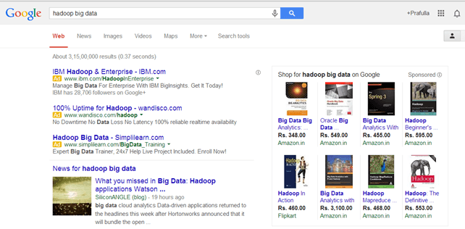
Examples Of Un-structured Data
The output returned by ‘Google Search’

Slide 10
Semi-structured Data
Semi-structured data can contain both the forms of data. We can see semi-structured data as a structured in form but it is actually not defined with e.g. a table definition in relational DBMS.
Example of semi-structured data is a data represented in an XML file.
Examples Of Semi-structured Data: Personal data stored in an XML file
<rec><name>Prashant Rao</name><sex>Male</sex><age>35</age></rec> <rec><name>Seema R.</name><sex>Female</sex><age>41</age></rec> <rec><name>Satish Mane</name><sex>Male</sex><age>29</age></rec> <rec><name>Subrato Roy</name><sex>Male</sex><age>26</age></rec> <rec><name>Jeremiah J.</name><sex>Male</sex><age>35</age></rec>

Slide 11
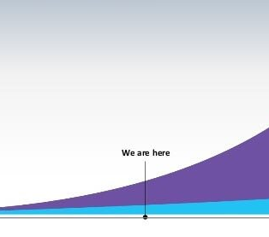
Examples Of Semi-structured Data
Data Growth over the years
Please note that web application data, which is unstructured, consists of log files, transaction history files etc. OLTP systems are built to work with structured data wherein data is stored in relations (tables).

Slide 12
Characteristics Of Big Data
Big data can be described by the following characteristics:
Volume
Variety
Velocity
Variability

Slide 13
Advantages Of Big Data Processing
Businesses can utilize outside intelligence while taking decisions
Improved customer service
Early identification of risk to the product/services, if any
Better operational efficiency

Slide 14
Difference Between Big Data & Cloud Computing
it’s important to form a clear distinction between “Big Data” and “Cloud Computing”. Although they are technically different terms, they’re often seen together in literature because they interact synergistically with one another.
Big Data: This simply refers to the very large sets of data that are output by a variety of programs. It can refer to any of a large variety of types of data, and the data sets are usually far too large to peruse or query on a regular computer.
Cloud Computing: This refers to the processing of anything, including Big Data Analytics, on the “cloud”. The “cloud” is just a set of high-powered servers from one of many providers. They can often view and query large data sets much more quickly than a standard computer could.
Essentially, “Big Data” refers to the large sets of data collected, while “Cloud Computing” refers to the mechanism that remotely takes this data in and performs any operations specified on that data.

Slide 15
Roles & Relationship Between Big Data & Cloud Computing
Cloud Computing providers often utilize a “software as a service” model to allow customers to easily process data. Typically, a console that can take in specialized commands and parameters is available, but everything can also be done from the site’s user interface. Some products that are usually part of this package include database management systems, cloud-based virtual machines and containers, identity management systems, machine learning capabilities, and more.
In turn, Big Data is often generated by large, network-based systems. It can be in either a standard or non-standard format. If the data is in a non-standard format, artificial intelligence from the Cloud Computing provider may be used in addition to machine learning to standardize the data.
From there, the data can be harnessed through the Cloud Computing platform and utilized in a variety of ways. For example, it can be searched, edited, and used for future insights.

Slide 16
Conclusion
Finally, it’s important to note that both Big Data and Cloud Computing play a huge role in our digital society. The two linked together allow people with great ideas but limited resources a chance at business success. They also allow established businesses to utilize data that they collect but previously had no way of analyzing.
More modern components of cloud infrastructure’s typical “Software as a Service” model such as artificial intelligence also enable businesses to get insights based on the Big Data they’ve collected. With a well-planned system, businesses can take advantage of all of this for a nominal fee, leaving competitors who refuse to use these new technologies in the dust.

Slide 17

Any Question

